Slide 1
CIS 581, Computer Vision, Fall 2018 Project Face Swapping in Videos
Abhijeet Singh Shikhar Brajesh
abhsingh@seas.upenn.edu shikharb@seas.upenn.edu

Slide 2

METHODOLOGY

Slide 3
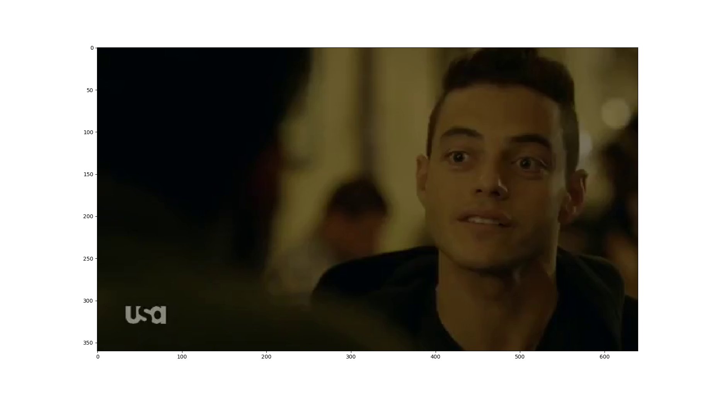
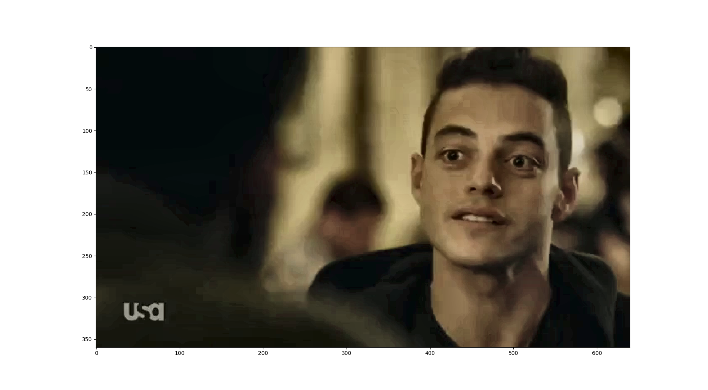
Facial Landmark Detection
Methods Tried : OpenCV Haar Cascades, Python Face Detection Library – Dlib (72 and 68 point versions)
Challenges: Lighting conditions (CLAHE)

Slide 4
Convex Hull of Face
Method Used : OpenCV convexHull function
Challenges: Need to include some facial landmark points for better swapping For maintaining source emotion –one internal point from each feature For maintaining target emotion – all internal points (some exceptions explained later) Note: Source is the face which will be replaced in Target Video. Target’s Body and Background is preserved. We have implemented both cases: Preserving Source Emotion as well as Target Emotion to avoid confusion.

Slide 5
Delaunay Triangulation
SCiPy’s Spatial function
Warping
Blending
OpenCV seamlessClone – NORMAL_CLONE best solved our purpose

Slide 6
Optical Flow
Increase throughput
Reduce Jitter
Frame Rate for Swap

Slide 7
Multiple Frames
Frontal Face to Side View and vice-versa
Left or Right Orientation using ratio of distances of eyes to nose tip
Person speaking or not using ratio of upper lip to nose tip and upper lip to bottom lip
Ratio = Scale Invariant of Facial Features

Slide 8
Source Emotion
Take single interior point from all facial landmarks for Delaunay triangulation step.
Avoids distorting source emotion.
Target Emotion
Take all interior points from all facial landmarks for Delaunay triangulation step.
Mimics target emotion.
Reduce number of points between lips, take centroid of eye boundary

Slide 9
Additional Features
Multiple face swaps in single frame
Optical Flow for real-time processing

Slide 10
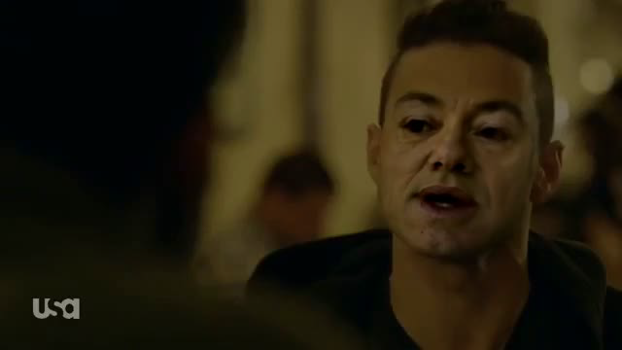
Preserving Target Emotion

Slide 11
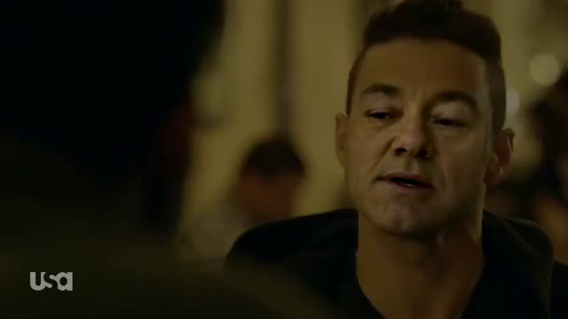
Preserving Source Emotion

Slide 12
Thank You

